Slide 1
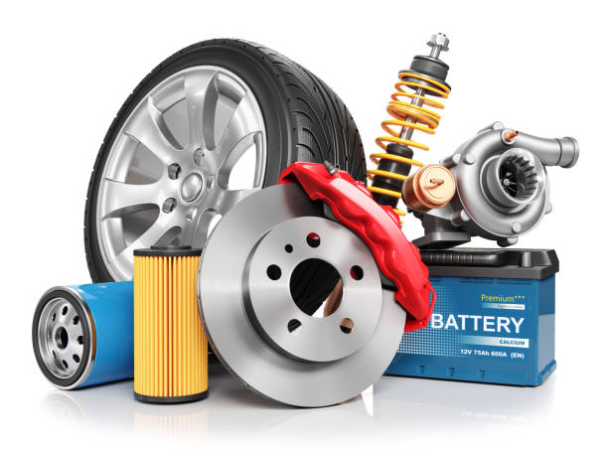
Automobile Spare Parts Management System
By-Ganraj Rajendra Dol

Slide 2
Content
Introduction to Automobile Spare Parts Management System
Introduction to Python with data science
Python Libraries for Data Science
Exploratory Data Analysis
Cross Validation
Decision Tree Algorithm
Conclusion

Slide 3
Introduction to Automobile Spare Parts Management System
Automobile Spare Parts Management System Project is implemented for managing the dealer, customers, claims, Parts, Transactions and also This system also provides an the company to check or analyze the part is in warranty or not and also provides company to check the Monthly report of Dealers and parts that has been failed &Predict the parts that may fail according to the location, mileage and age. Company to understand Monthly report of top ten failed parts with the help of this system they can check Quality of the parts, Pattern of failure mostly reported failed part in the quarter/year. Automobile Spare Parts Management System is an application using Google Co-laboratory in Python with data science

Slide 4
Introduction to Python with data science
Python is a dynamic, object-oriented, high-level programming language that can be used for many kinds of software development. Python programming language was created by Guido van Rossum. Python got its name from the BBC comedy series “Monty Python’s Flying Circus”. Guido van Rossum needed a name that was short, unique, and slightly mysterious. Since he was a fan of the show he thought this name was great. Python is an interpreter, interactive, object-oriented programming language. It incorporates modules, exceptions, dynamic typing, very high level dynamic data types, and classes. It supports multiple programming paradigms beyond object-oriented programming, such as procedural and functional programming. Python combines remarkable power with very clear syntax. It has interfaces to many system calls and libraries, as well as to various window systems, and is extensible in C or C++. It is also usable as an extension language for applications that need a programmable interface. Python is portable: it runs on many UNIX variants including Linux and macOS, and on Windows.

Slide 5
Features of Python Programming language:
At present, there are many programming languages, and everyone has its own unique and different feature. It is the feature which matters the most and helps planning of choosing the best programming language for a project. So, you should know about the Python Programming language before you decide which is better for you. For knowing a language, you should know the feature, below are the features that will clear your thoughts about why Python over R or any other roots.
Easy to code and Read
High-Level Programming Language
Portable
Expressive
Object Oriented
Free and Open Source
Interpreted
Extensible
Embeddable
Large and Standard Library
GUI programming
Dynamically Typed

Slide 6
Applications for Python
Python is used in many application domains.
The Python Package Index lists thousands of third party modules for Python.
Web and Internet Development
Python offers many choices for web development:
Frameworks such as Django and Pyramid.
Micro-frameworks such as Flask and Bottle.
Advanced content management systems such as Plone and Django CMS.
Python's standard library supports many Internet protocols:
HTML and XML
JSON
E-mail processing.
Support for FTP, IMAP, and other Internet protocols.
Easy-to-use socket interface.
And the Package Index has yet more libraries:
Requests, a powerful HTTP client library.
Beautiful Soup, an HTML parser that can handle all sorts of oddball HTML.
Feedparser for parsing RSS/Atom feeds.
Paramiko, implementing the SSH2 protocol.
Twisted Python, a framework for asynchronous network programming.
Microsoft Foundation Classes through the win32 extensions

Slide 7
Data science
Data science is the study of data. Like biological sciences are a study of biology, physical sciences, it’s the study of physical reactions. Data is real, data has real properties, and we need to study them if we’re going to work on them. Data Science involves data and some signs.
It is a process, not an event. It is the process of using data to understand too many different things, to understand the world. when you have a model or proposed explanation of a problem, and you try to validate that proposed explanation or model with your data. It is the skill of unfolding the insights and trends that are hiding (or abstract) behind data. It’s when you translate data into a story. So use storytelling to generate insight. And with these insights, you can make strategic choices for a company or an institution.
We can also define data science as a field which is about processes and systems to extract data of various forms and from various resources whether the data is unstructured or structured.
The definition and the name came up in the 1980s and 1990s when some professors, IT Professionals, scientist were looking into the statistics curriculum, and they thought it would be better to call it data science and then later on data analytics derived.

Slide 8
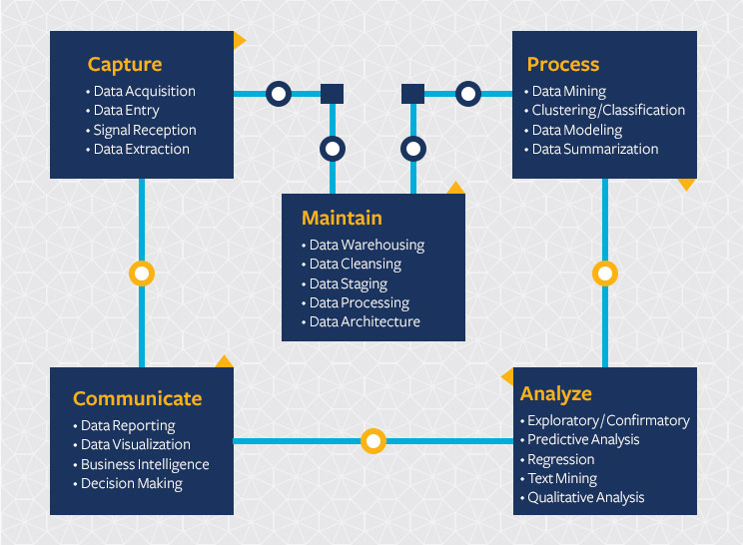
Data science features and applications
Data science continues to evolve as one of the most promising and in-demand career paths for skilled professionals. Today, successful data professionals understand that they must advance past the traditional skills of analyzing large amounts of data, data mining, and programming skills. In order to uncover useful intelligence for their organizations, data scientists must master the full spectrum of the data science life cycle and possess a level of flexibility and understanding to maximize returns at each phase of the process.

Slide 9
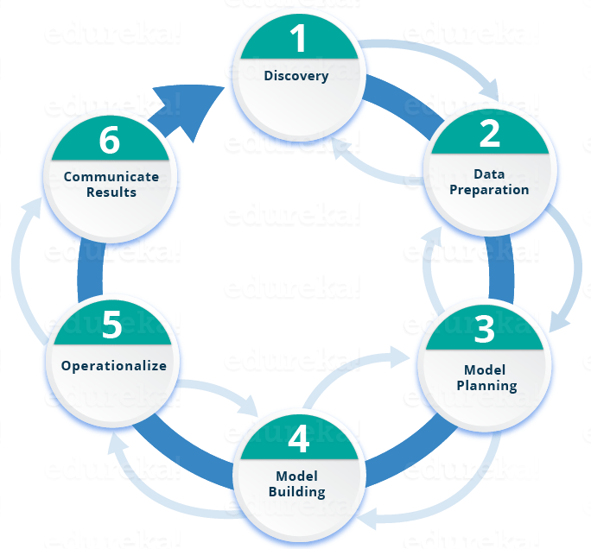
Lifecycle of Data Science

Slide 10
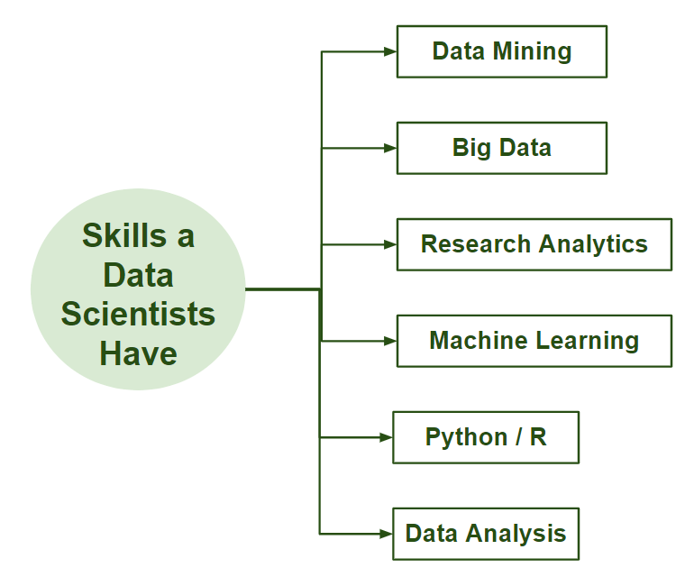
Data Scientist
There are several definitions available on Data Scientists. In simple words, a Data Scientist is one who practices the art of Data Science. The term “Data Scientist” has been coined after considering the fact that a Data Scientist draws a lot of information from the scientific fields and applications whether it is statistics or mathematics.
What does a Data Scientist do?
Data scientists are those who crack complex data problems with their strong expertise in certain scientific disciplines. They work with several elements related to mathematics, statistics, computer science, etc (though they may not be an expert in all these fields). They make a lot of use of the latest technologies in finding solutions and reaching conclusions that are crucial for an organization’s growth and development. Data Scientists present the data in a much more useful form as compared to the raw data available to them from structured as well as unstructured forms.

Slide 11




Phase 1—Discovery: Before you begin the project, it is important to understand the various specifications, requirements, priorities and required budget. You must possess the ability to ask the right questions. Here, you assess if you have the required resources present in terms of people, technology, time and data to support the project. In this phase, you also need to frame the business problem and formulate initial hypotheses (IH) to test.
Phase 2—Data preparation: In this phase, you require analytical sandbox in which you can perform analytics for the entire duration of the project. You need to explore, preprocess and condition data prior to modeling. Further, you will perform ETLT (extract, transform, load and transform) to get data into the sandbox. Let’s have a look at the Statistical Analysis flow below.
Phase 3—Model planning: Here, you will determine the methods and techniques to draw the relationships between variables. These relationships will set the base for the algorithms which you will implement in the next phase. You will apply Exploratory Data Analytics (EDA) using various statistical formulas and visualization tools.
Phase 4—Model building: In this phase, you will develop datasets for training and testing purposes. Here you need to consider whether your existing tools will suffice for running the models or it will need a more robust environment (like fast and parallel processing).

Slide 12


Phase 5—operationalize: In this phase, you deliver final reports, briefings, and code and technical documents. In addition, sometimes a pilot project is also implemented in a real-time production environment. This will provide you a clear picture of the performance and other related constraints on a small scale before full deployment.
Phase 6—Communicate results: Now it is important to evaluate if you have been able to achieve your goal that you had planned in the first phase. So, in the last phase, you identify all the key findings, communicate to the stakeholders and determine if the results of the project are a success or a failure based on the criteria developed in Phase.

Slide 13
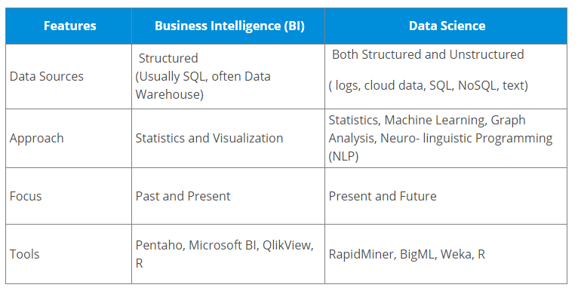
Business Intelligence (BI) vs. Data Science
Business Intelligence (BI) basically analyzes the previous data to find hindsight and insight to describe business trends. Here BI enables you to take data from external and internal sources, prepare it, run queries on it and create dashboards to answer questions like quarterly revenue analysis or business problems. BI can evaluate the impact of certain events in the near future.
Data Science is a more forward-looking approach, an exploratory way with the focus on analyzing the past or current data and predicting the future outcomes with the aim of making informed decisions. It answers the open-ended questions as to “what” and “how” events occur

Slide 14
System Analysis:
- Hardware Requirements:
Processor : i3 processor
Memory : 4 GB RAM
Display : 14’’ LCD
Hard disk Drive : 120 GB
- Software Requirements : Google Co-laboratory,
Jupyternotebook
Operating System : Windows 7, 8.1,10.

Slide 15
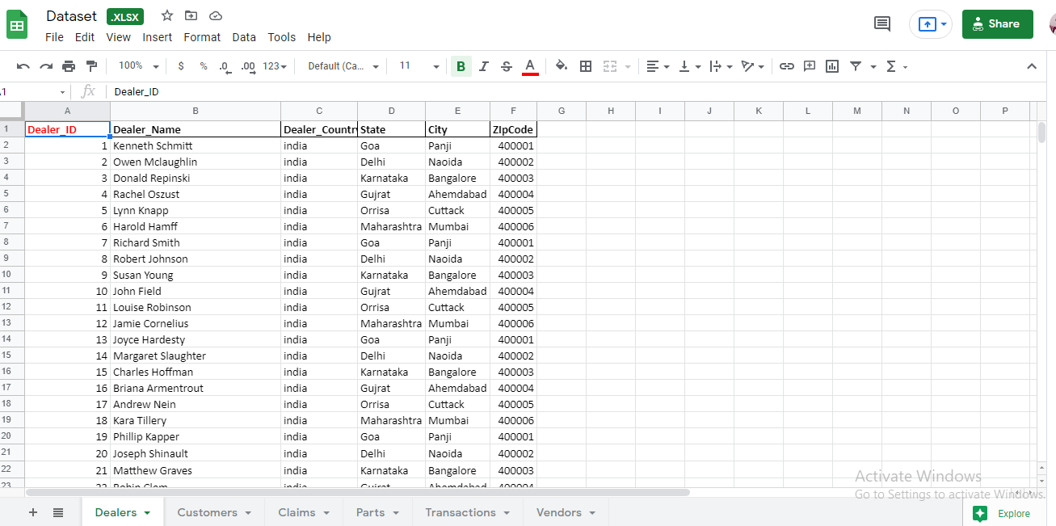
Datasets
Dealers

Slide 16
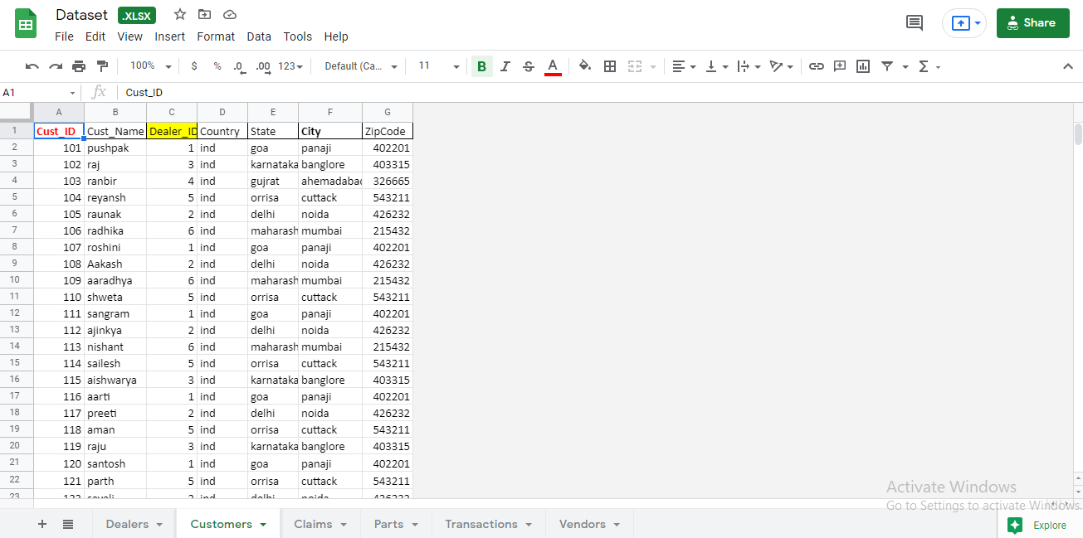
Customers

Slide 17
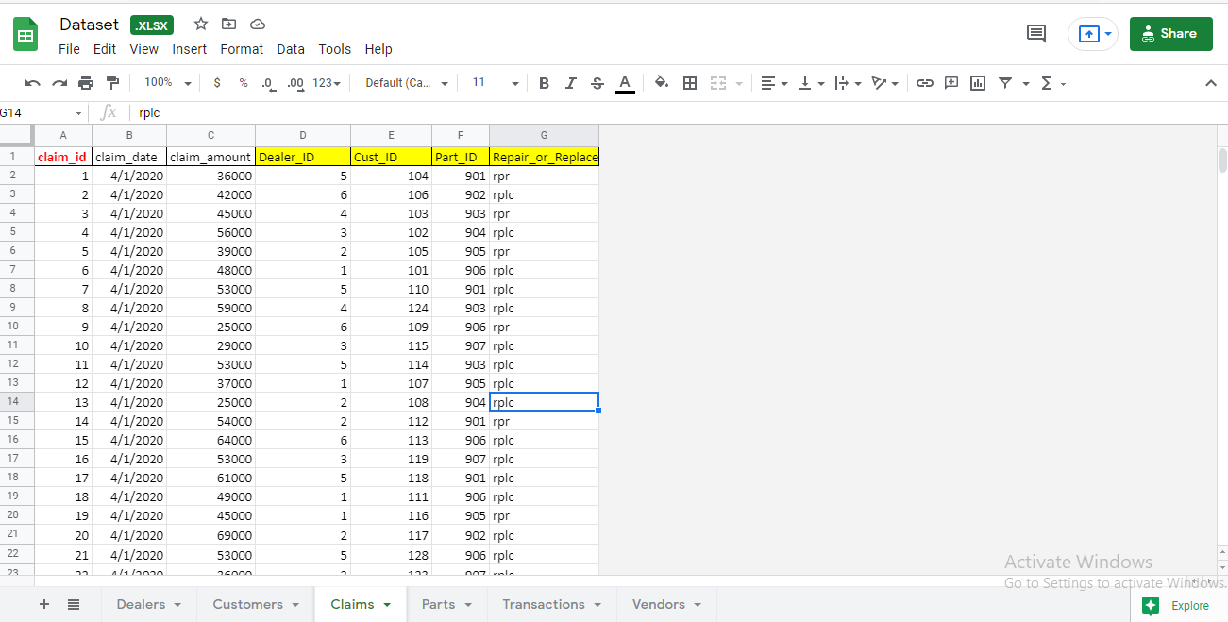
Claims

Slide 18
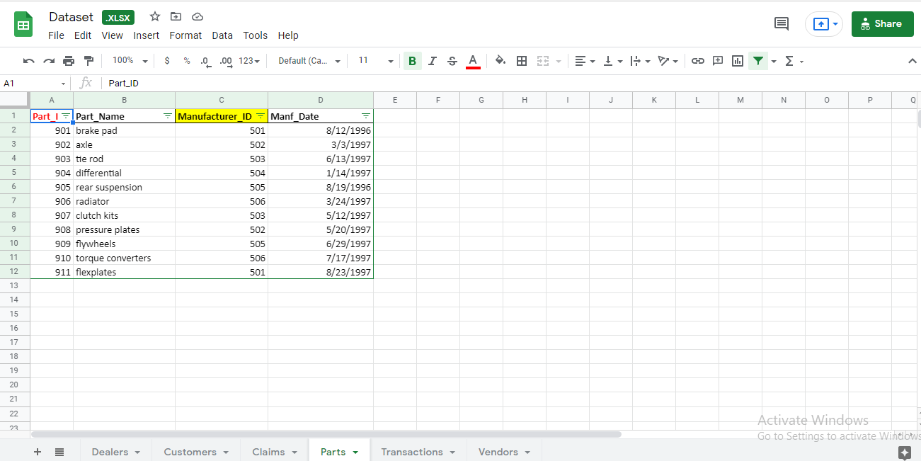
Parts

Slide 19
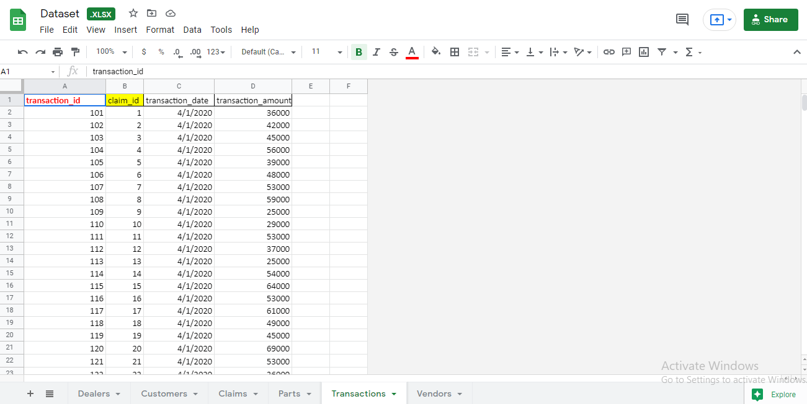
Transactions

Slide 20
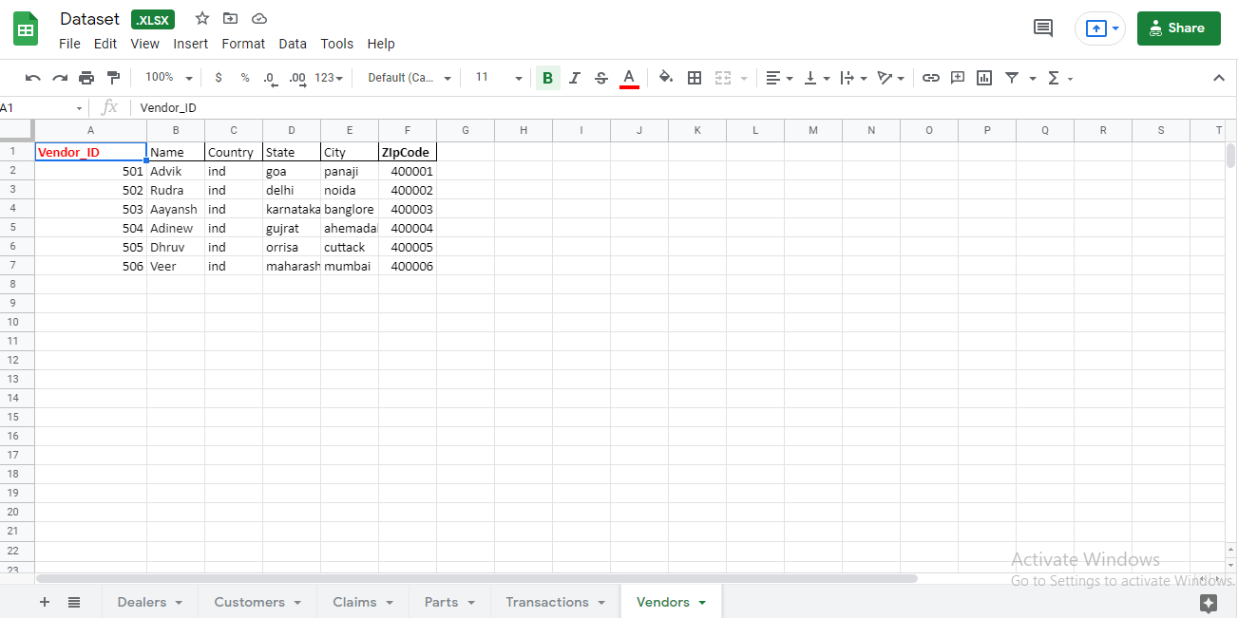
Vendors

Slide 21
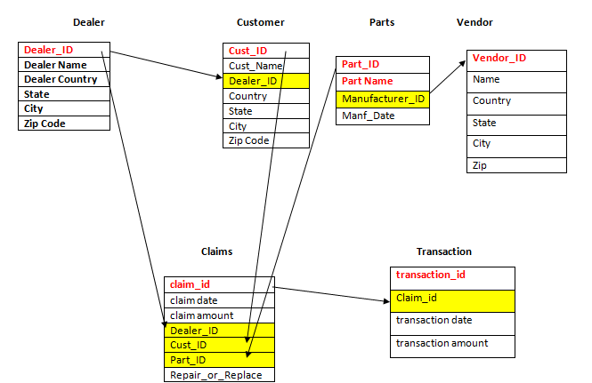
diagram

Slide 22
Python Libraries for Data Science
Many popular Python toolboxes/libraries:
NumPy
Pandas
SciKit-Learn
Visualization libraries
matplotlib
Seaborn

Slide 23
NumPy:
introduces objects for multidimensional arrays and matrices, as well as functions that allow to easily perform advanced mathematical and statistical operations on those objects
provides vectorization of mathematical operations on arrays and matrices which significantly improves the performance
many other python libraries are built on NumPy
Pandas:
adds data structures and tools designed to work with table-like data (similar to Series and Data Frames in R)
provides tools for data manipulation: reshaping, merging, sorting, slicing, aggregation etc.
allows handling missing data
SciKit-Learn:
provides machine learning algorithms: classification, regression, clustering, model validation etc.
built on NumPy, SciPy and matplotlib

Slide 24
matplotlib:
python 2D plotting library which produces publication quality figures in a variety of hardcopy formats
a set of functionalities similar to those of MATLAB
line plots, scatter plots, barcharts, histograms, pie charts etc.
relatively low-level; some effort needed to create advanced visualization
Seaborn:
based on matplotlib
provides high level interface for drawing attractive statistical graphics
Similar (in style) to the popular ggplot2 library in R

Slide 25
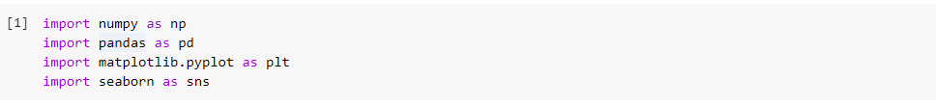
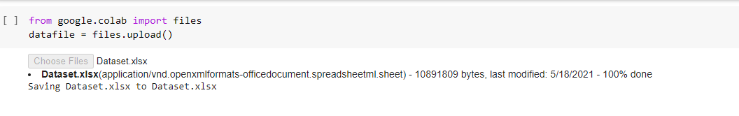
Loading Python Libraries
Loading Data

Slide 26
Loading Python Libraries
Loading Data

Slide 27
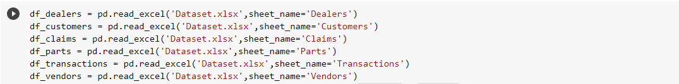
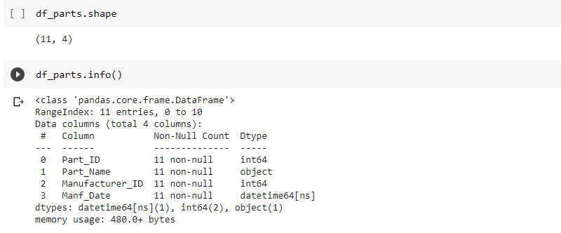
Data Preparations and Cleaning
Reading Data
To read dataset we have to import pandas and by using read_csv() function of pandas we can read data which have csv format. After reading we determined it's shape i.e rows and columns ,it's information. We can also find mean ,median ,mode etc. After that we used drop() function to remove coloumns which are not needed for analysis.

Slide 28
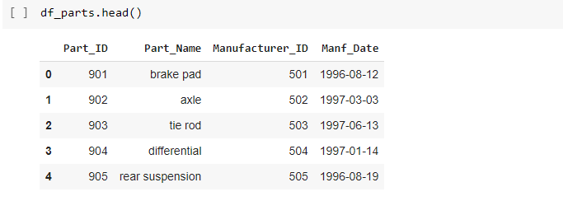
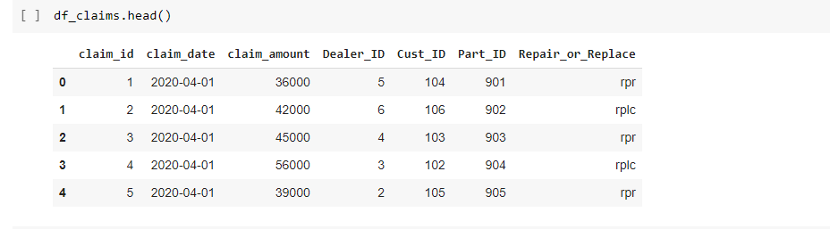
Exploring data frames

Slide 29
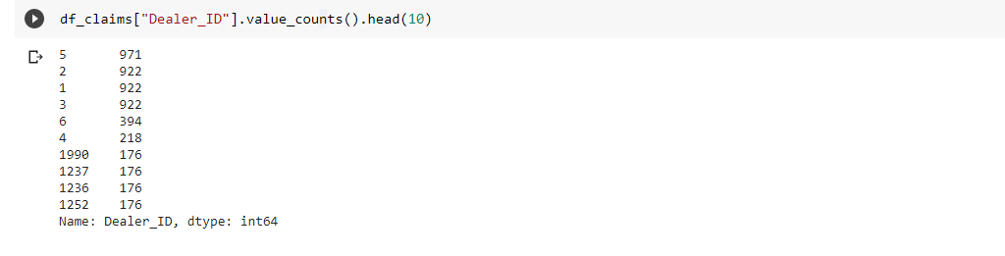
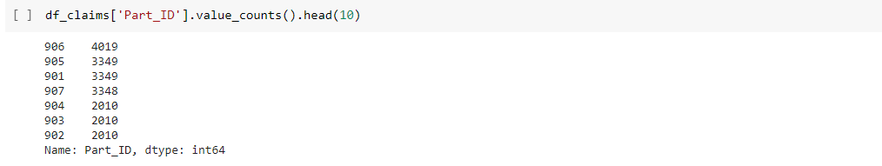
Monthly report of top Dealers who have claimed with high count
Monthly report of top parts which have high failed count

Slide 30
Exploratory Data Analysis (EDA)
Exploratory Data Analysis refers to the critical process of performing initial investigations on data so as to discover patterns, to spot anomalies, to test hypothesis and to check assumptions with the help of summary statistics and graphical representations. (For this example pandas, numpy, matplotlib and seaborn) and loaded the data set. EDA is an approach to analyze the data and find patterns, visual insights, etc. that the data set is having, before proceeding to model. One spends a lot of time doing EDA to get a better understanding of data
Data Quality Check: Can be done using pandas library functions like describe(), info(), dtypes(), etc. It is used to find several features, its datatypes, duplicate values, missing value, etc.
Statistical Test: Some statistical tests like Pearson correlation, Spearman correlation, Kendall test, etc are done to get a correlation between the features. It can be implemented in python using the stats library.
Quantitative Test: Some quantitative test is used to find the spread of numerical features, count of categorical features. It can be implemented in python using the functions of the pandas library.
Visualization: Feature visualization is very essential to get an understanding of the data. Graphical techniques like bar plots, pie charts are used to get an understanding of categorical features, whereas scatter plots, histograms are used for numerical features.

Slide 31
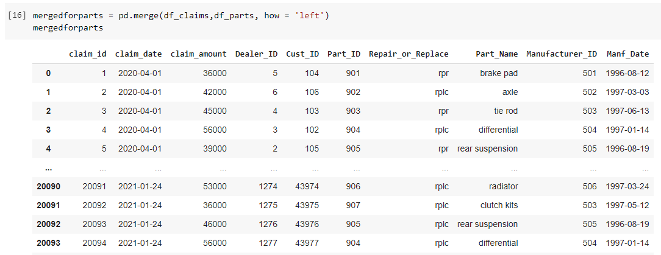

Slide 32
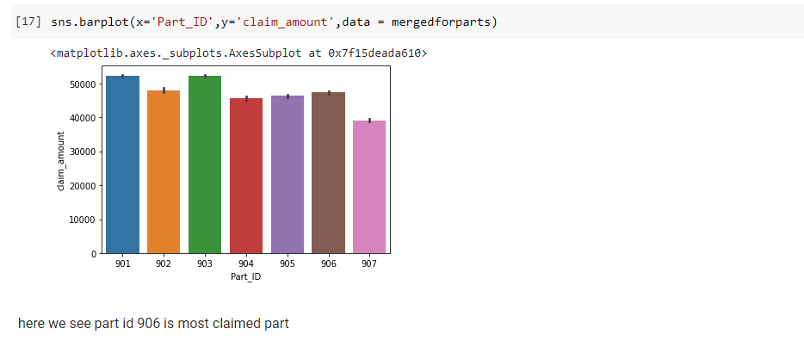
barplot

Slide 33
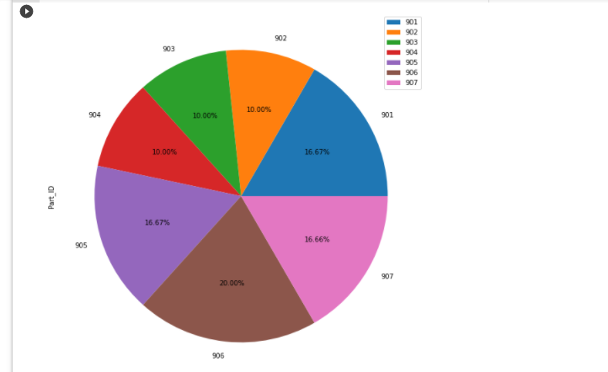
pie chart

Slide 34
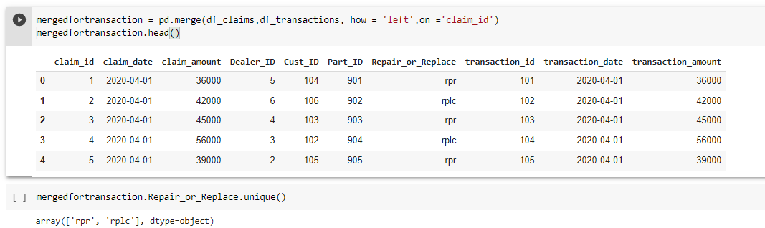
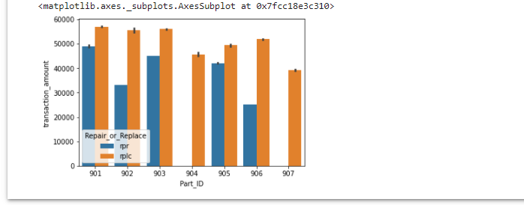
Transaction amount of repair and replace by part

Slide 35
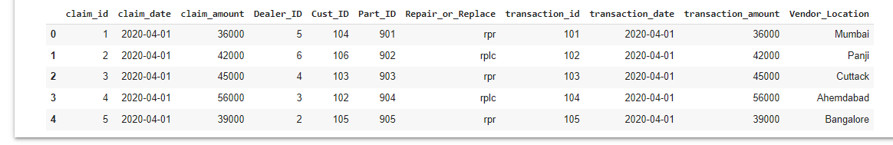
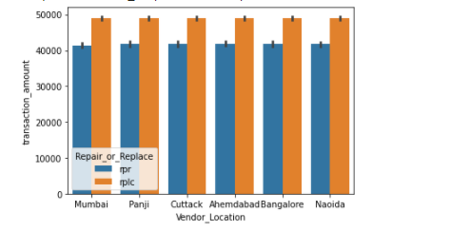
Predicting the parts that may fail according to the location

Slide 36
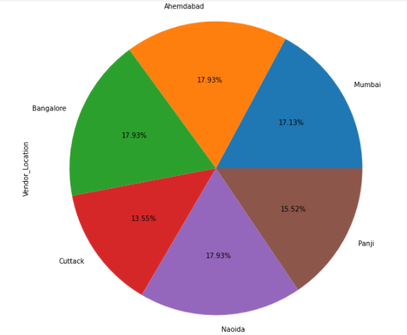
pie chart

Slide 37
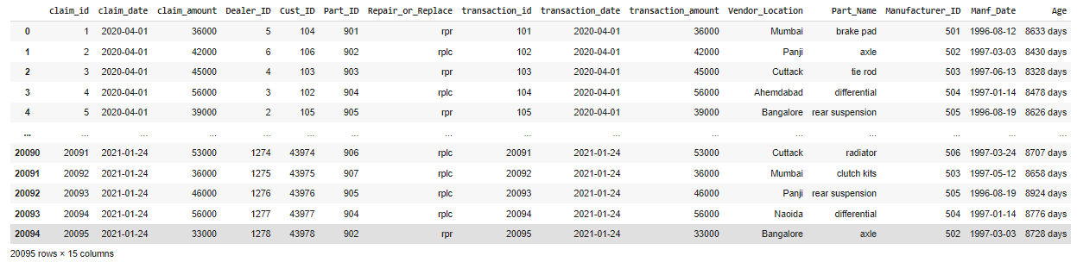
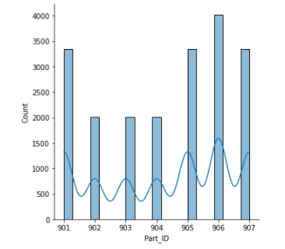
Predicting the parts that may fail according to the Age
displot

Slide 38
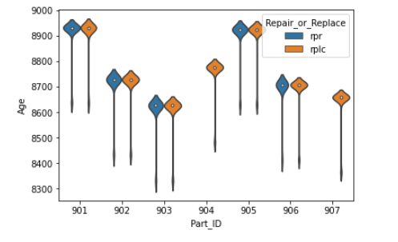
violinplot

Slide 39
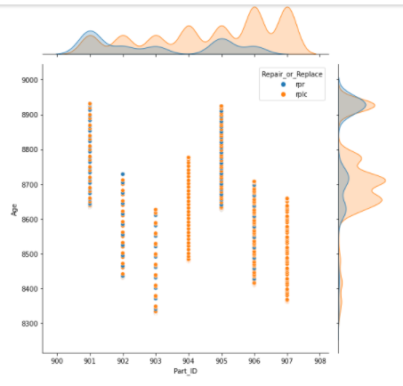
jointplot

Slide 40
Cross Validation
Validation
This process of deciding whether the numerical results quantifying hypothesized relationships between variables, are acceptable as descriptions of the data, is known as validation. Generally, an error estimation for the model is made after training, better known as evaluation of residuals. In this process, a numerical estimate of the difference in predicted and original responses is done, also called the training error. However, this only gives us an idea about how well our model does on data used to train it. Now its possible that the model is underfitting or overfitting the data. So, the problem with this evaluation technique is that it does not give an indication of how well the learner will generalize to an independent/ unseen data set. Getting this idea about our model is known as Cross Validation.
Holdout Method
Now a basic remedy for this involves removing a part of the training data and using it to get predictions from the model trained on rest of the data. The error estimation then tells how our model is doing on unseen data or the validation set. This is a simple kind of cross validation technique, also known as the holdout method. Although this method doesn’t take any overhead to compute and is better than traditional validation, it still suffers from issues of high variance. This is because it is not certain which data points will end up in the validation set and the result might be entirely different for different sets.

Slide 41
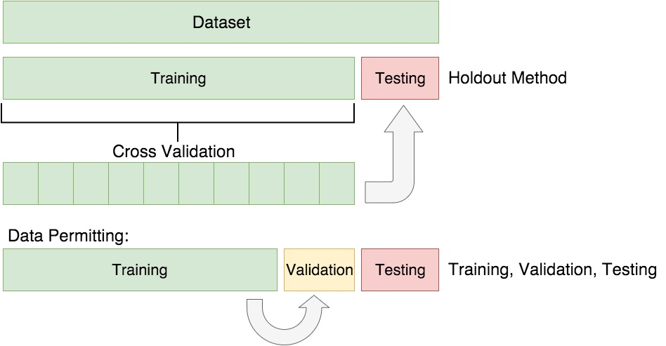
K-Fold Cross Validation
As there is never enough data to train your model, removing a part of it for validation poses a problem of underfitting. By reducing the training data, we risk losing important patterns/ trends in data set, which in turn increases error induced by bias. So, what we require is a method that provides ample data for training the model and also leaves ample data for validation. K Fold cross validation does exactly that.

Slide 42
Variations on Cross-Validation
There are a number of variations on the k-fold cross validation procedure.
Three commonly used variations are as follows:
Train/Test Split: Taken to one extreme, k may be set to 2 (not 1) such that a single train/test split is created to evaluate the model.
LOOCV: Taken to another extreme, k may be set to the total number of observations in the dataset such that each observation is given a chance to be the held out of the dataset. This is called leave-one-out cross-validation, or LOOCV for short.
Stratified: The splitting of data into folds may be governed by criteria such as ensuring that each fold has the same proportion of observations with a given categorical value, such as the class outcome value. This is called stratified cross-validation.
Repeated: This is where the k-fold cross-validation procedure is repeated n times, where importantly, the data sample is shuffled prior to each repetition, which results in a different split of the sample.

Slide 43
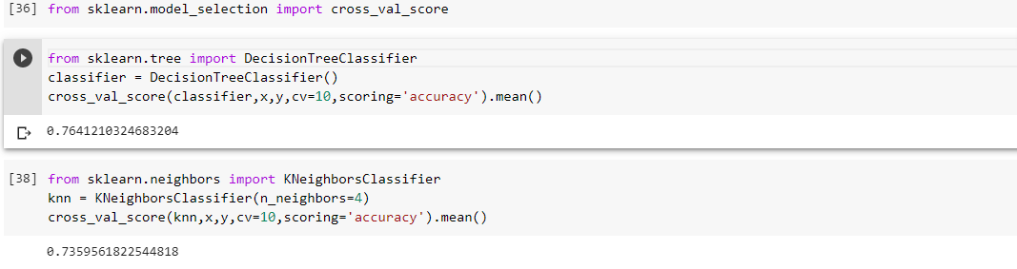
Nested: This is where k-fold cross-validation is performed within each fold of cross-validation, often to perform hyperparameter tuning during model evaluation. This is called nested cross-validation or double cross-validation.
here we see best accuracy by DecisionTreeCLassifier , so we are u sing decision tree classifier for further process

Slide 44
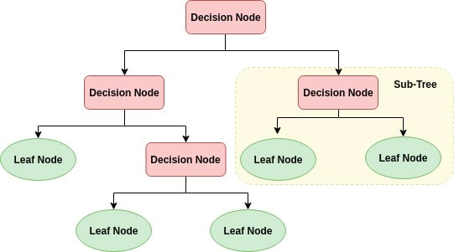
Decision Tree Algorithm
A decision tree is a flowchart-like tree structure where an internal node represents feature(or attribute), the branch represents a decision rule, and each leaf node represents the outcome. The topmost node in a decision tree is known as the root node. It learns to partition on the basis of the attribute value. It partitions the tree in recursively manner call recursive partitioning. This flowchart-like structure helps you in decision making. It's visualization like a flowchart diagram which easily mimics the human level thinking. That is why decision trees are easy to understand and interpret.

Slide 45
Decision Tree is a white box type of ML algorithm. It shares internal decision-making logic, which is not available in the black box type of algorithms such as Neural Network. Its training time is faster compared to the neural network algorithm. The time complexity of decision trees is a function of the number of records and number of attributes in the given data. The decision tree is a distribution-free or non-parametric method, which does not depend upon probability distribution assumptions. Decision trees can handle high dimensional data with good accuracy.

Slide 46
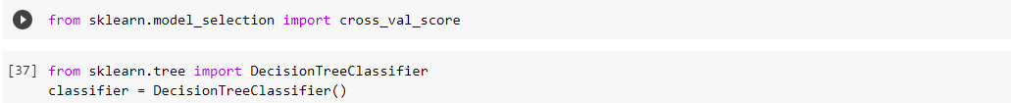
Decision Tree Classifier Building in Scikit-learn
Importing Required Libraries
Building Decision Tree Model
Evaluating Model
Let's estimate, how accurately the classifier or model can predict the type of cultivars.Accuracy can be computed by comparing actual test set values and predicted values.

Slide 47
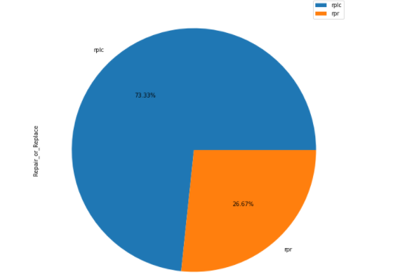
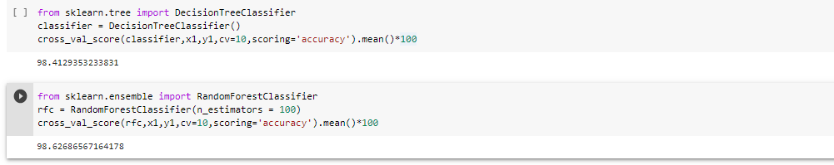
To determine whether the defective part is to be replaced or repaired

Slide 48
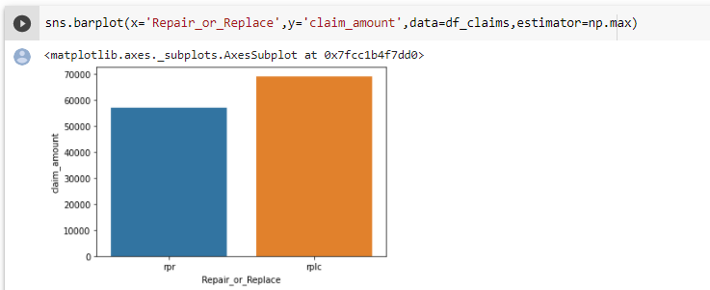
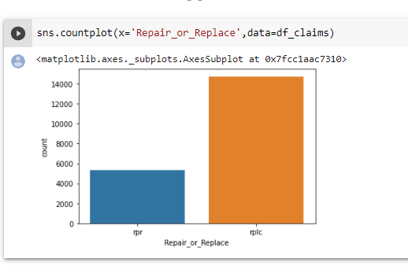

Slide 49
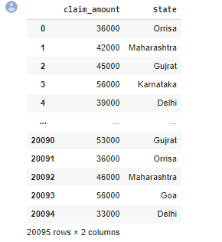
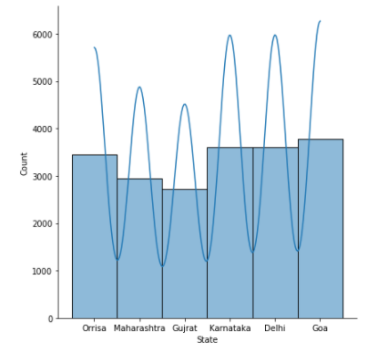
Processing of variety of data
displot

Slide 50
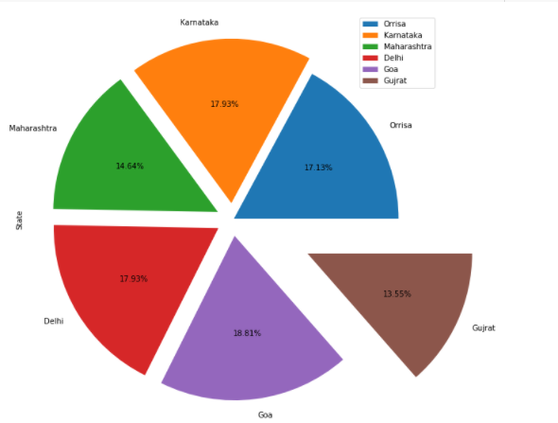

Slide 51
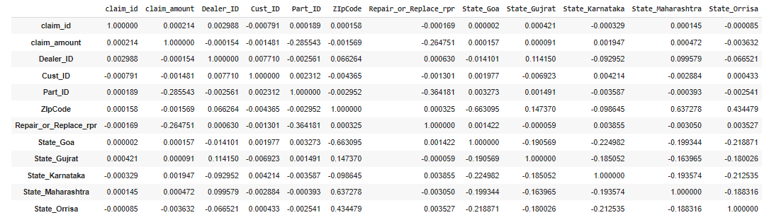
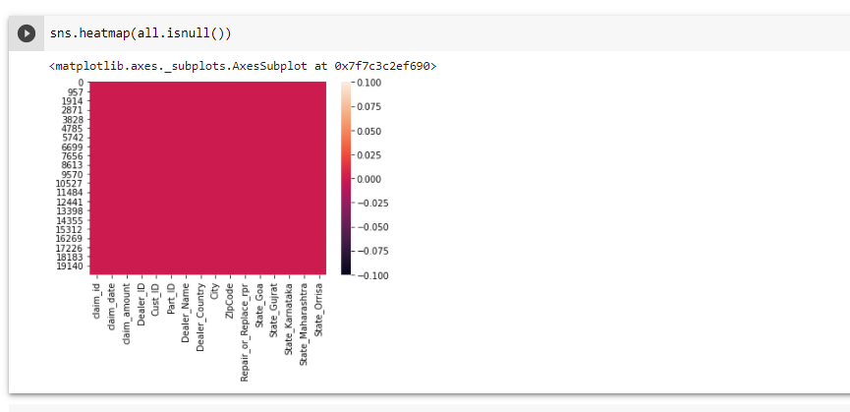

Slide 52
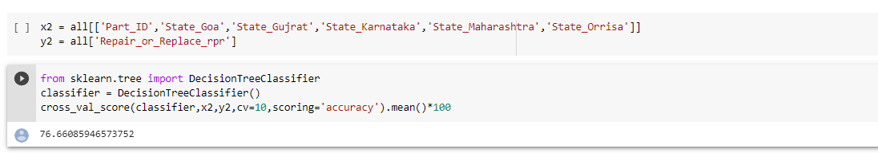

Slide 53
Conclusion
The System is to be designed in such a manner that it eliminates all communication and coordination barriers and also reduces shortcomings and limitations of existing systems
Dealer ID 5 claimed parts monthly 971 times.
Part_ID 906 is most failed part.
Majority of the Parts are being replaced.
Parts in Goa are among the most claimed parts.
variety of data accuracy 76.68

Slide 54
Bibliography.
Books -: Python Programming Fundamentals- A Beginner's Handbook by Nischay kumar Hegde
Websites -:
http://www.wikipedia.org/
https://www.kaggle.com/
https://colab.research.google.com/notebooks/intro.ipynb
https://pandas.pydata.org/
https://seaborn.pydata.org/
https://scikit-learn.org/stable/

Slide 55
Thank You

